Slide 1

Module Code: SOFT40161 Module Name: Introduction to Computer Programming Lecture 03: Data Structure in Python and Code Quality Consideration (Week 12:03)
M. Arifur Rahman, PhD
Department of Computer Science, NTU
Arif.Rahman@ntu.ac.uk

Slide 2
Module Contents and Our Plan!
Lecture | Week | Topic | Comment
Lecture 01 | Week 11 | Module Introduction, Programming Basics: Python Environment, Installation, Variables, Data Types and Operations | Done!
Lecture 02 | Week 12 | Procedural Programming: Control Structures with Python (Sequence, Branching, Conditions and Looping) | Done!
Lecture 03 | Week 13 | Data Structures Concepts in Python (Lists, Tuples, Sets and Dictionaries), Code Quality Considerations and Critical Appraisal | This Week!
Lecture 04 | Week 14 | Functions, Modules, Argument Passing, Recursion and Exceptions
Lecture 05 | Week 15 | Concepts of Object-Oriented Programming (Classes, Methods, and Constructors)
Lecture 06 | Week 16 | Working with Data: File I/O and Data Handling and NumPy Operations
Lecture 07 | Week 17 | Data Manipulation with Pandas and Python Libraries
Lecture 08 | Week 18 | Data Visualization: Basic to Customisation
Lecture 09 | Week 19 | Working with Real-World Data, Python for Machine Learning
Lecture 10 | Week 20 | GUI with Python, Coursework, Projects and Review

Slide 3
Learning Outcomes (LO) of this module:
LO-01: Understand Python Data Structures: Learn lists, tuples, sets, and dictionaries.
LO-02: Manipulate Data: Practice accessing and modifying these structures.
LO-03: Differentiate Structures: Know when to use mutable vs. immutable types.
LO-04: Apply Code Quality: Implement readability, maintainability, and error handling.
LO-05: Error Handling: Learn basic debugging and handling errors in Python.

Slide 4
Roadmap for today
Arrays Indexing & Slicing
Tuples, Dictionaries, Lists
Binary Trees
Code Qualities
Error Handling

Slide 5
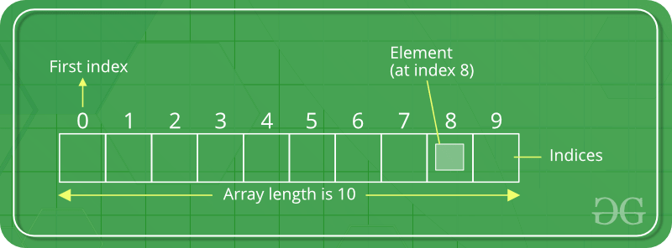
Array
Store multiple items of the same type together.
Collection of items stored at connecting memory locations
Python does not have built-in support for Arrays, we can use Python Lists

Slide 6
Array indexing
Python provides a lot of built in checks when accessing arrays (other languages don’t)
Have to consider what happens
at the beginning and end of the arrays.
Why?
Traceback (most recent call last):
File "<pyshell#35>", line 1, in <module>
name[6]
IndexError: string index out of range
0
1
2
3
4
5
name = “PWhite”
P
W
h
i
t
e
name[3] -> ‘i’
name[5] -> ‘e’
memory
name[6] -> ?
8
0
1
2
3
4
5
0
1
2
3
4
What happens with: name[-1] -> ?
q
P
W
h
i
t
e
L
L
a
n
e
name
name2

Slide 7
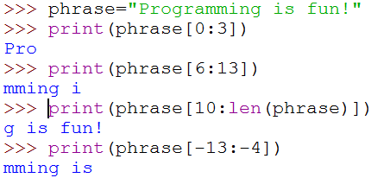
Array Slices
As well as single elements, we can get slices from strings – sub-sequences of their content, by specifying the start index and end index.

Slide 8
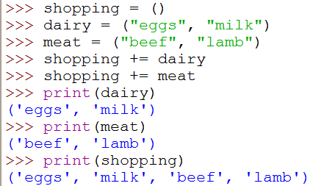
Tuples
A tuple is a sequence – not just of characters but of practically anything!
Anything you could assign to a variable, you can put in a tuple
A tuple is a bunch of stuff in brackets separated by commas (that’s why commas have to be used carefully)
You can index, slice and concatenate tuples like strings
Empty tuple

Slide 9
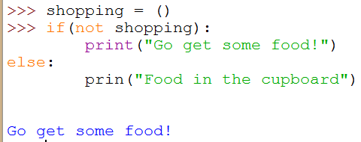
Tuples
An empty tuple will evaluate to False as a condition
So you can check whether a tuple has any contents and do something conditional on that
Tuples are also immutable like strings – so we cannot change an element in one
shopping is False, so
not shopping evaluates to True

Slide 10
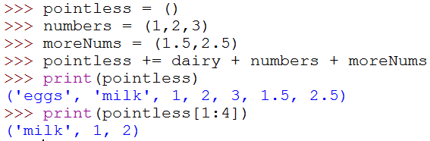
Tuples can have mixed element types
Again, we create a new tuple from pointless plus the other bits, and update pointless by replacing it by the new one

Slide 11
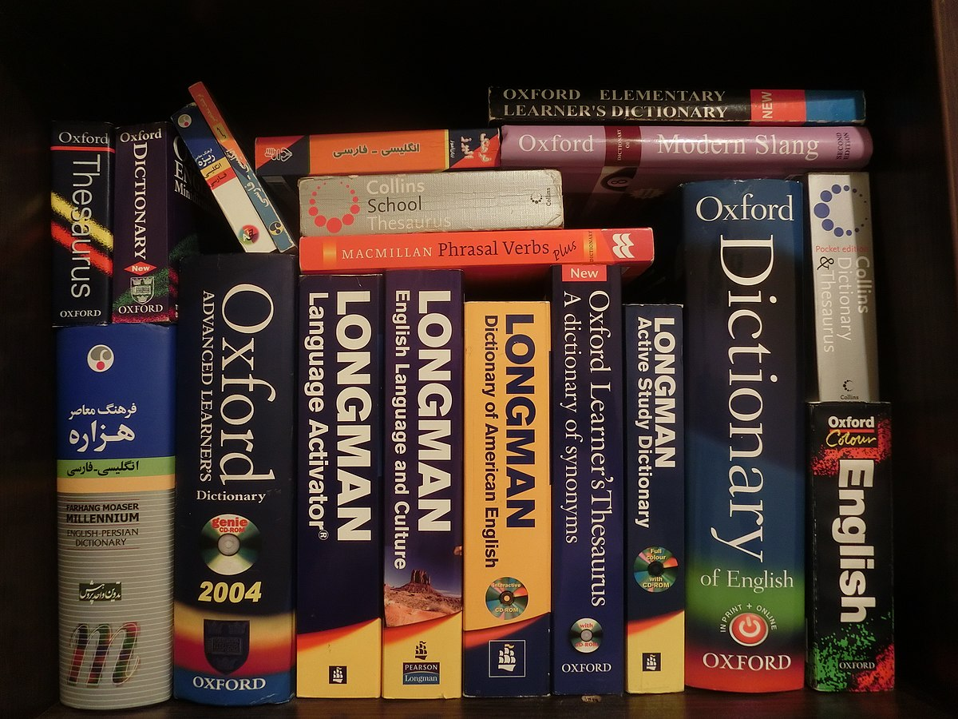
Dictionaries
A DICTIONARY is a structure that
allows you to use something as a key to look up a value
<key>=<value>
Dictionaries use braces { } (not brackets or square brackets)
But they still use [ ] to access elements
Again they are mutable, so we can add and remove “key-value pairs”
If a key is not present in a dictionary, using it can generate an error unless you use the get() method
You cannot add a repeat key to a dictionary
Once a key is in the dictionary, you CANNOT change it –you can only change the value associated with it
If you have put a key in wrong, you would have to remove the pair, then add a new one to change it
You can always change the value associated with a key
https://en.wikipedia.org/wiki/Dictionary
py_dic= { 1:’Apple’,
2: ‘Orange’}

Slide 12
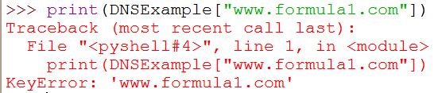

Dictionaries – creating & adding
If a key is not already present, we add it and an associated value.
or,
We can display stored information:
We can add to a dictionary …

Slide 13
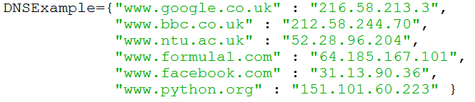


Dictionaries – removing elements
There are times where we need to remove an element from a dictionary.
We can’t just do:
We need to “pop” it off the dictionary:
You can also remove all elements from a dictionary:

Slide 14
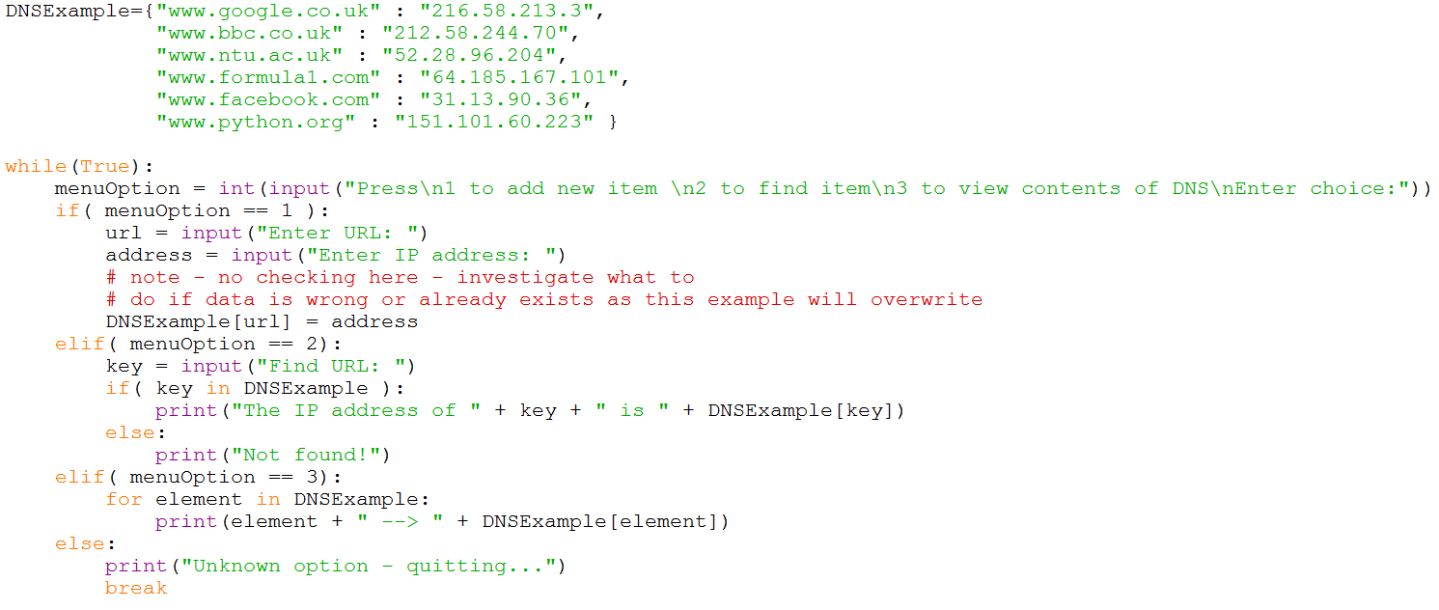
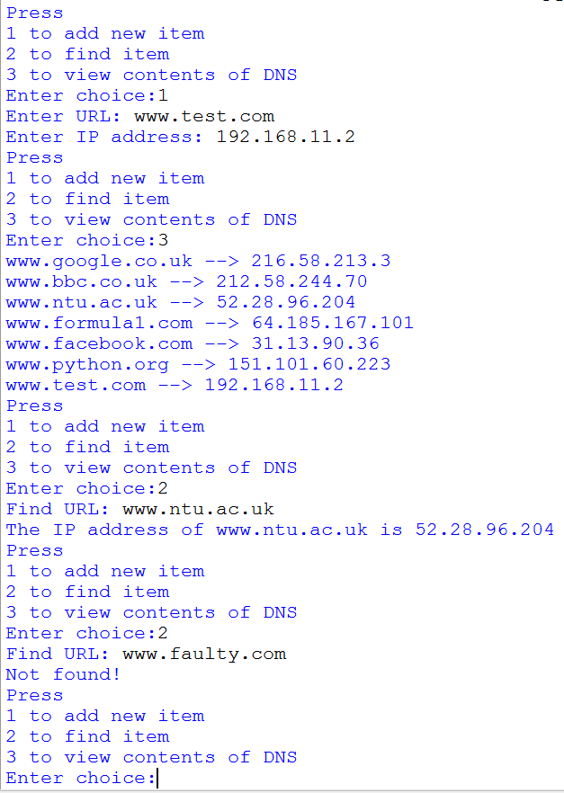
Dictionaries – doing something useful

Slide 15
Lists
Linked lists are dynamic data structures.
They can keep on growing.
An element contains a data and pointer component.
The pointer points to the next element in the list.
data
Memory location
>>> mylist = []
>>> mylist.append(5)
>>> mylist.append(10)
>>> mylist
[5, 10]
5
NULL
mylist
NULL
10
NULL
15

Slide 16





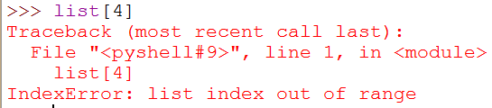
Lists - adding and accessing elements
A list can be created by using []
You can also populate a list when you create it:
To add to an existing list we need to use “append”:
To access an element, you need to specify the index (be careful!):

Slide 17
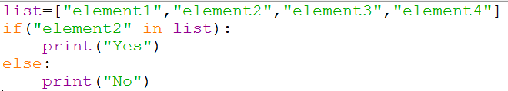
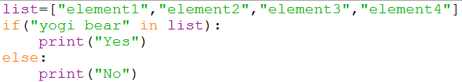






Lists – finding and removing
We can check to see if an item is in a list:
We can also search for an item using a for loop:
To remove an item:

Slide 18
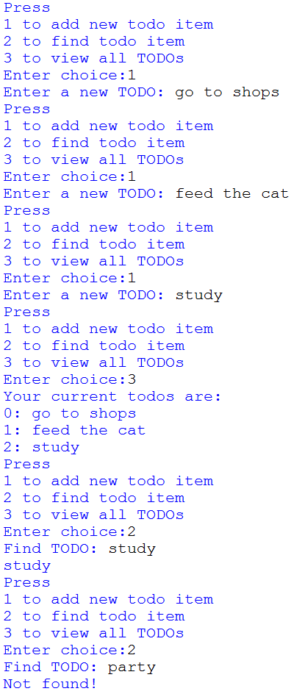
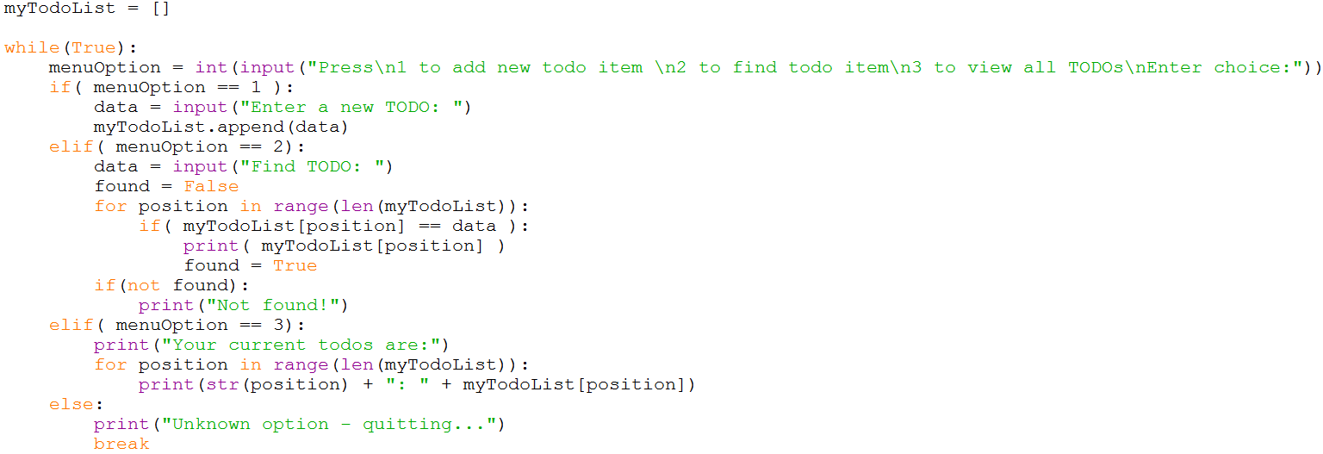
List example

Slide 19
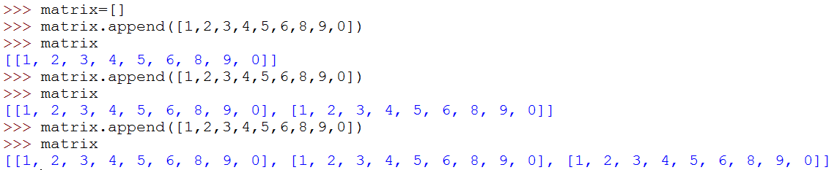
Lists in lists
You can also have lists within lists…
For every element in the list, there is another list.
0
1
2
listOfNames = [ [“PWhite”,98878],
[“Ckent”,727383],
[“Llane”,827290] ]
0
0
0
1
1
1

Slide 20
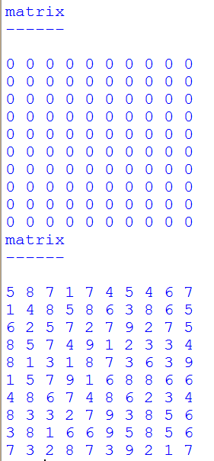
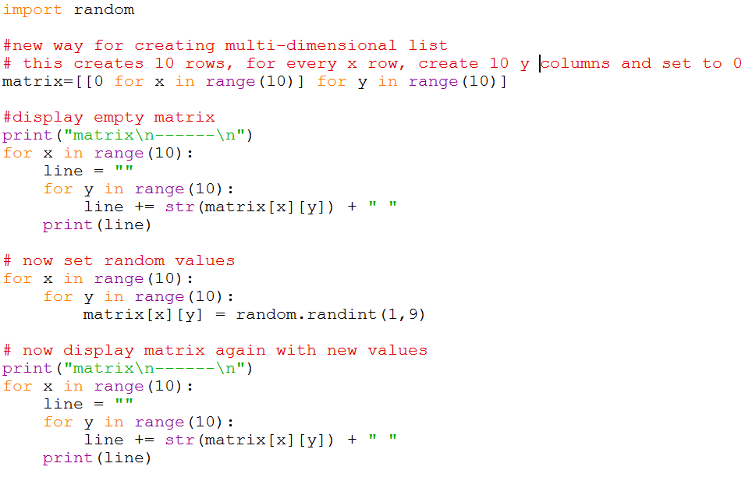
Lists in lists

Slide 21
Advanced topics: Binary Trees
A advanced data structure which can be used to sort and traverse data.
A binary tree is comprised of a set of nodes.
Each node is interconnected by an edge.
For instance:
Parent
Left child will contain information less than the parent.
Right child will contain information greater than the parent.
Child
Child

Slide 22
Binary Trees
Parent
10
Right child will contain information greater than the parent.
Left child will contain information less than the parent.
Child
5
Child
15
Parent
10
X
Child
56
Child
5

Slide 23
Binary Trees: Inserting nodes
Step 1: Empty tree
Root = None
Check to see if root = None
If it is, set root = new node
Step 2: Add node with data = 100
Root =
100
Step 3: Add node with data = 150
Check to see if root is a node
If it is, check to see which direction to go:
If node_{new} < root -> left
If node_{new} > root -> right
150 > 100, add node to root_{right}
Root =
100
150

Slide 24
Binary Trees: Inserting nodes
Check to see if root is a node
If it is, check to see which direction to go:
If node_{new} < root -> left
If node_{new} > root -> right
Need to go left (child = root_{left})
Is child a node?
Yes, check to see which direction to go:
If node_{new} < child -> left
If node_{new} > child -> right.
Need to go right
Is child_{right} a node?
No, so add new node here
Step 4: Add node with data = 75
100
Check to see if root is a node
If it is, check to see which direction to go:
If node_{new} < root -> left
If node_{new} > root -> right
Need to go left.
Is root_{left} a node?
No, add node to root_{left}.
Root =
75
150
Step 5: Add node with data = 90
Root =
100
75
150
90

Slide 25
Binary Trees: Inserting nodes
Check to see if root is a node
If it is, check to see which direction to go:
If node_{new} < root -> left
If node_{new} > root -> right
Need to go left (child = root_{left})
Is child a node?
Yes, check to see which direction to go:
If node_{new} < child -> left
If node_{new} > child -> right.
Need to go left
Is child_{left} a node?
No, so add new node here
Check to see if root is a node
If it is, check to see which direction to go:
If node_{new} < root -> left
If node_{new} > root -> right
Need to go left (child = root_{left})
Is child a node?
Yes, check to see which direction to go:
If node_{new} < child -> left
If node_{new} > child -> right.
Need to go right
Is child_{right} a node? ( child = child_{right})
Yes, check to see which direction to go:
If node_{new} < child -> left
If node_{new} > child -> right.
Is child_{left} a node?
No, so add new node here
Step 6: Add node with data = 60
Step 7: Add node with data = 80
100
Root =
100
Root =
75
150
75
150
60
90
60
90
80

Slide 26
Binary Trees (unbalanced)
The tree that was being built currently looks like:
This is not very efficient, as it is lop sided (i.e. unbalanced).
One of the main reasons for using trees is that it is very fast to locate or check to see if data is contained within the structure.
If you want to check to see if 80 is contained within the tree you will need to do 3 hops.
Root =
100
75
150
60
90
80
Ideally, we need a tree which is balanced…

Slide 27
Code Quality
Code quality refers to how well-written, efficient, and maintainable a piece of code is.
High-quality code is easy to read, debug, and extend over time, and it performs efficiently with minimal bugs.
Importance in Programming:
Maintainability: Code is easier to modify, update, or fix when it's clear and well-organized.
Readability: Helps others (and yourself) understand the logic, making collaboration.
Scalability: Clean code can scale as the system grows, preventing performance bottlenecks.
Efficiency: Optimized code ensures faster execution, better resource management, and improved user experience.
Error Reduction: Well-structured code minimizes the chances of bugs and security vulnerabilities.
Key Message: Investing time in writing high-quality code saves more time in debugging and future improvements.

Slide 28
Key Aspects of Code Quality
Readability
Maintainability
Clear, well-organized code that's easy to understand.
Efficiency
Testability
Reliability
Modular, easy-to-update code with consistent structure.
Optimized performance with minimal redundancy.
Easily testable code with clear inputs/outputs.
Code that handles errors well and functions as expected.

Slide 29
Writing Clean and Readable Code
Use Descriptive Names
Consistent Indentation
Keep Functions Short
Give variables and functions meaningful names.
Follow consistent formatting rules throughout.
Break complex tasks into smaller, manageable functions.

Slide 30
Code Documentation Standards
Comment Key Sections
Explain non-obvious parts of the code to aid understanding.
Use Docstrings
Provide clear descriptions for functions and methods using Python’s """docstring""" format.
Include Usage Examples
Where relevant, show examples of how functions or classes are used.
Version Control Notes
Document major changes in code through version control systems like Git.
Follow Style Guides
Adhere to established coding standards like PEP 8 for consistency.

Slide 31
Error Handling in Python
Try-Except Blocks
Specific Exceptions
Finally Clause
Raise Exceptions
Logging Errors
Use try and except to catch and handle runtime errors without crashing the program.
Catch specific exceptions (e.g., ValueError, IndexError) instead of using a generic except.
Use finally to execute code (like cleanup) that runs regardless of whether an exception occurred.
Use raise to trigger exceptions when detecting invalid conditions in your code.
Log error details for debugging instead of just printing them, ensuring information is retained.

Slide 32
Techniques for Critical Appraisal:
Code Reviews:
Static Analysis Tools
Unit Testing
Profiling
Peer review can help identify issues and improve code quality.
Automated tools can detect potential problems like syntax errors, code smells, and security vulnerabilities.
Writing tests for individual code units can help verify correctness and identify regressions.
Analyzing the performance of the code can help identify bottlenecks and areas for optimization.

Slide 33

Coursework

Slide 34

Voluntary Research Opportunity @ISRG
Determination
Basic ML Knowledge
Programming Skills

Slide 35


